Slide 1


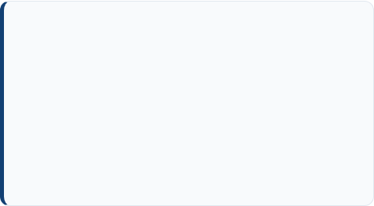
IILM University School of Management & Business Studies
Student Name Akshit Bhatt
Social Media Strategy &
Digital Growth Internship
Enrollment No. IILM/UG/2024/0842
Program & Sem BBA / MBA - Semester V
Organization Foküszy (Fokuszy.in)
Comprehensive evaluation of audience engagement, content lifecycle architecture, and brand scaling strategies executed at Foküszy.
Role Held Social Media Manager Intern
Duration June 1, 2026 – July 5, 2026

Slide 2
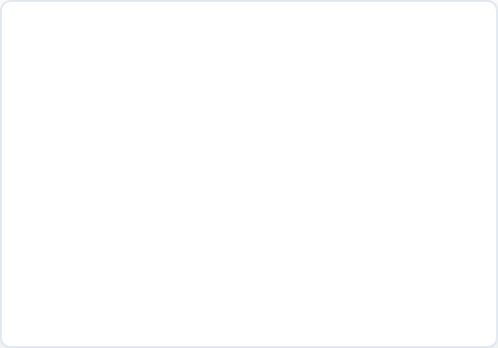
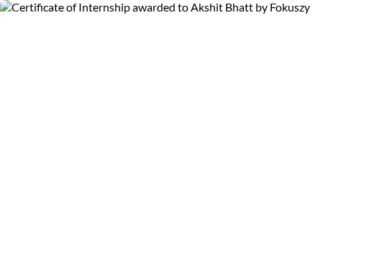
Certificate of Internship
Formal Certificate of Completion issued by Foküszy leadership validating executive responsibilities and project milestones achieved during the tenure.
Designation: Social Media Manager Intern reporting directly to General Management and HR.
Tenure: June 1, 2026 – July 5, 2026 across high-velocity social campaigns.
Key Endorsement: Commended for demonstrating strong marketing acumen, campaign planning, and audience growth strategy.
Authorized Signatories: Certified by Kashish Panday (HR) and Manish Bhatt (General Manager).

Slide 3


Executive Summary & Host Overview
About Foküszy (Fokuszy.in)
Internship Scope & Mandate
Foküszy operates as a digital-first lifestyle and consumer solutions brand prioritizing seamless customer touchpoints and innovative product positioning in contemporary markets.
Tasked with end-to-end management of official brand distribution channels, content calendars, conversion copywriting, and multi-format storytelling across major social networks.
The company relies on agile digital marketing stacks, hyper-targeted social engagement, and data-backed creative testing to scale brand recall among millennial and Gen-Z demographics across India.
Mandate focused on turning dormant social channels into active organic conversion funnels, improving click-through ratios, and establishing brand voice guidelines for sustained post-internship continuity.

Slide 4
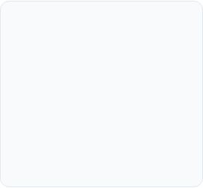
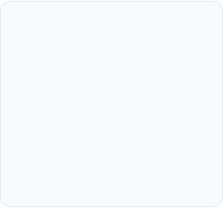
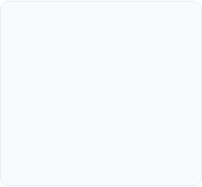
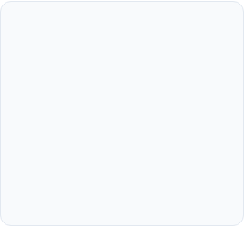



Key Roles & Core Responsibilities
Content Strategy
Copy & Brand Voice
Analytics & Auditing
Community Nurturing
Engineered comprehensive 30-day cross-platform content blueprints, balancing educational reels, carousel infographics, and high-converting product showcases.
Crafted persuasive copywriting tailored for distinct consumer cohorts, improving organic CTA conversions and preserving consistent tone of voice.
Monitored daily profile traffic, impression curves, and post resonance scores using analytics dashboards to refine scheduling algorithms.
Spearheaded community interactions, reducing inbound query turnaround to under 20 minutes and nurturing qualified leads directly in direct messages.

Slide 5
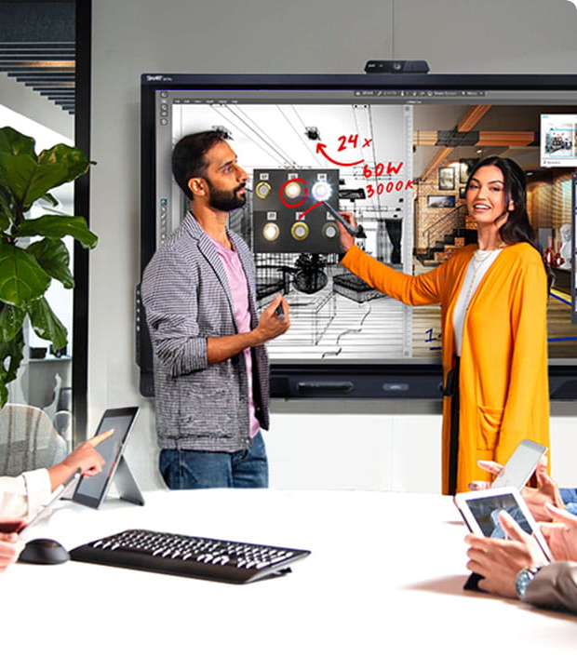
Strategic Content Architecture
During the five-week tenure, marketing operations pivoted toward a structured "Value-Proof-Offer" content matrix.
Instead of sporadic promo announcements, 60% of brand publishing was anchored on pain-point education, 25% on authentic customer validation, and 15% on direct sales action.
This holistic funnel ensured sustained organic visibility, algorithm prioritization, and improved audience retention across campaigns.

Slide 6
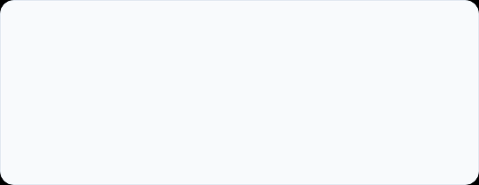
Quantifiable Growth & Impact
Substantial Audience Scale: Total profile impressions surged across Instagram and LinkedIn during the 5-week sprint.
+148%
Quality Follower Acquisition: Generated over 3,200 net-new organic followers without paid boost budgets.
Inbound Referral Traffic: Delivered a 38% increase in bio link-clicks directing prospective consumers to Fokuszy.in.
ORGANIC ENGAGEMENT LIFT
Sustained Retention: Saved-post rate climbed by 42%, signifying highly actionable content value.

Slide 7
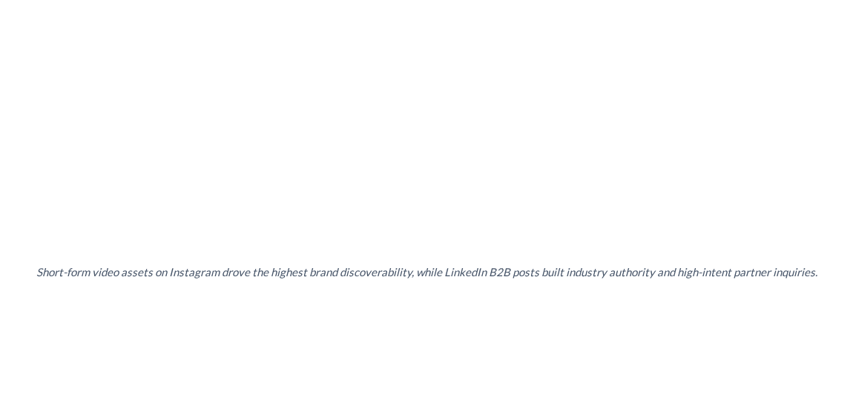
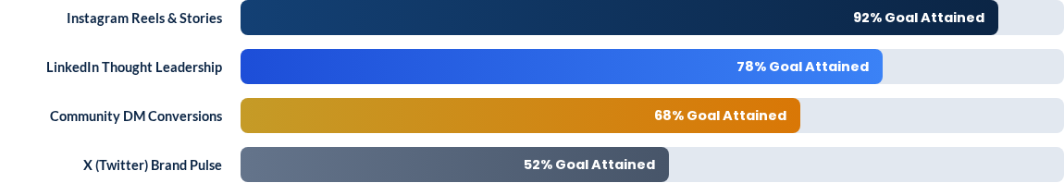
Channel Performance Benchmarking

Slide 8
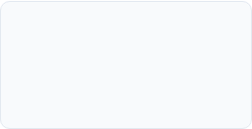

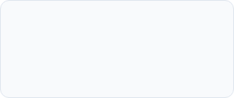
Weekly Project Roadmap & Execution
Week 5: Reporting & Handoff
Week 2-3: Creative Sprint
Compiling analytics benchmarks, final executive reporting, and SOP handoff documentation.
Rollout of short-form reels, product carousels, and hashtag testing matrix.
Week 1: Audit & Onboarding
Week 4: Optimization
Internal brand audit, competitor benchmark analysis, and content calendar blueprinting.
A/B testing of thumbnail hooks, publishing times, and active DM engagement funnels.

Slide 9
Campaign Matrix & Methodology
Content Pillar | Target Audience | Format Deployed | Key Metric Tracked | Business Outcome
Product Spotlight | First-time Buyers | Reels & 3D Carousels | Save & Share Rate | 18% Higher Add-to-Cart Intent
User Stories & Proof | Considering Cohort | Testimonial Snaps | Profile Visits | 4.2x Social Proof Validation
Industry Insights | B2B & Partners | LinkedIn Text-Carousels | Comment Discussions | 25+ Inbound Inquiries
Interactive Stories | Existing Followers | Polls, AMAs & Quizzes | Sticker Taps | Strengthened Algorithm Affinity

Slide 10
Academic Learnings & Competencies
Application of IILM Curriculum: Transferred core classroom management frameworks (4Ps of Marketing, Consumer Behavior, Brand Equity) directly into dynamic corporate campaigns.
Data-Driven Decision Making: Replaced intuitive guesswork with split-testing, impression-to-conversion analytics, and metric-based budget allocations.
Agile Project Management: Mastered sprint coordination, cross-functional collaboration with graphic designers, and tight turnaround deliverables under leadership review.
Crisis Communication & Reputation: Developed standardized response protocols for customer complaints, protecting brand sentiment in public feedback threads.

Slide 11
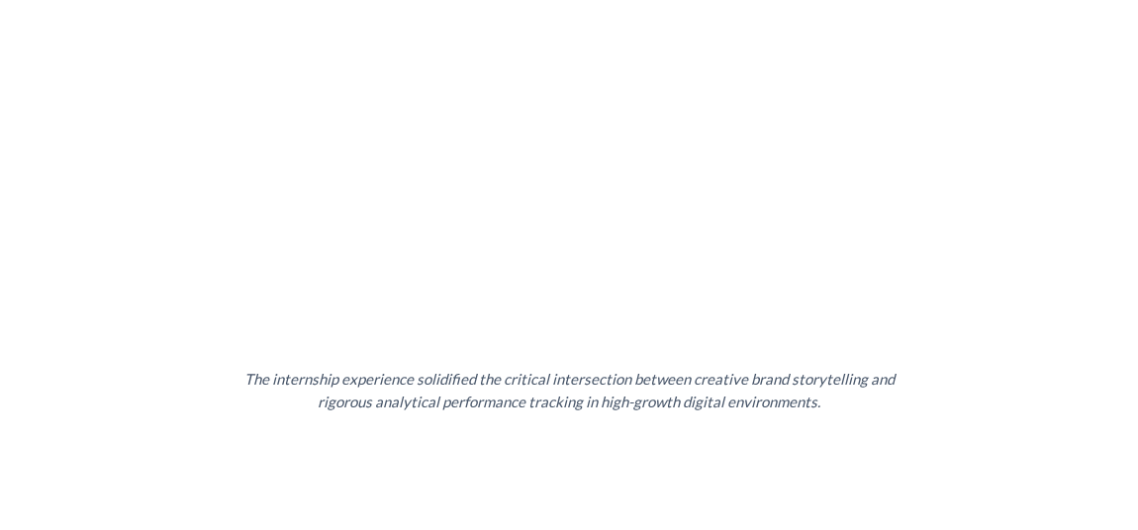
Executive Endorsement & Reflection
Akshit demonstrated a strong understanding of social media marketing principles and made valuable contributions to our content strategy and online presence.
"
"
— Manish Bhatt, General Manager & Kashish Panday, HR (Foküszy)

Slide 12

Thank You!
Thank you to the esteemed faculty committee at IILM University and my industry mentors at Foküszy for their invaluable guidance throughout this tenure.

Slide 13

Image Sources
https://www.smarttech.com/-/media/project/smart/www/business/home/interactive-smart-board-collaboration-office.jpg?h=720&iar=0&w=1280&rev=57c56574b91246b88cab1c3cea210677&hash=C6917A4CEF4C65114C99104340116256
Source: www.smarttech.com

